Slide 1
104-R
Downloading 104-R on a PFW’s computer.
Personal Computers may vary
Use Adobe Acrobat DC
Don’t Use Word or Excel to fill in

Slide 2
Google – PFW ROTC

Slide 3
Click ROTC Forms

Slide 4
Click CC 104-R Planned

Slide 5
Click Arrow to download

Slide 6
Click ‘^’ at the bottom

Slide 7
Click ‘Show in Folder’

Slide 8
Click Desktop – Click Save

Slide 9
Right-Click on the CCFORM104R Place Cursor on ‘Open with’ Click ‘Adobe Acrobat DC

Slide 10
Click ‘Yes’

Slide 11
Sign in with PFW email

Slide 12
Login with PFW login

Slide 13
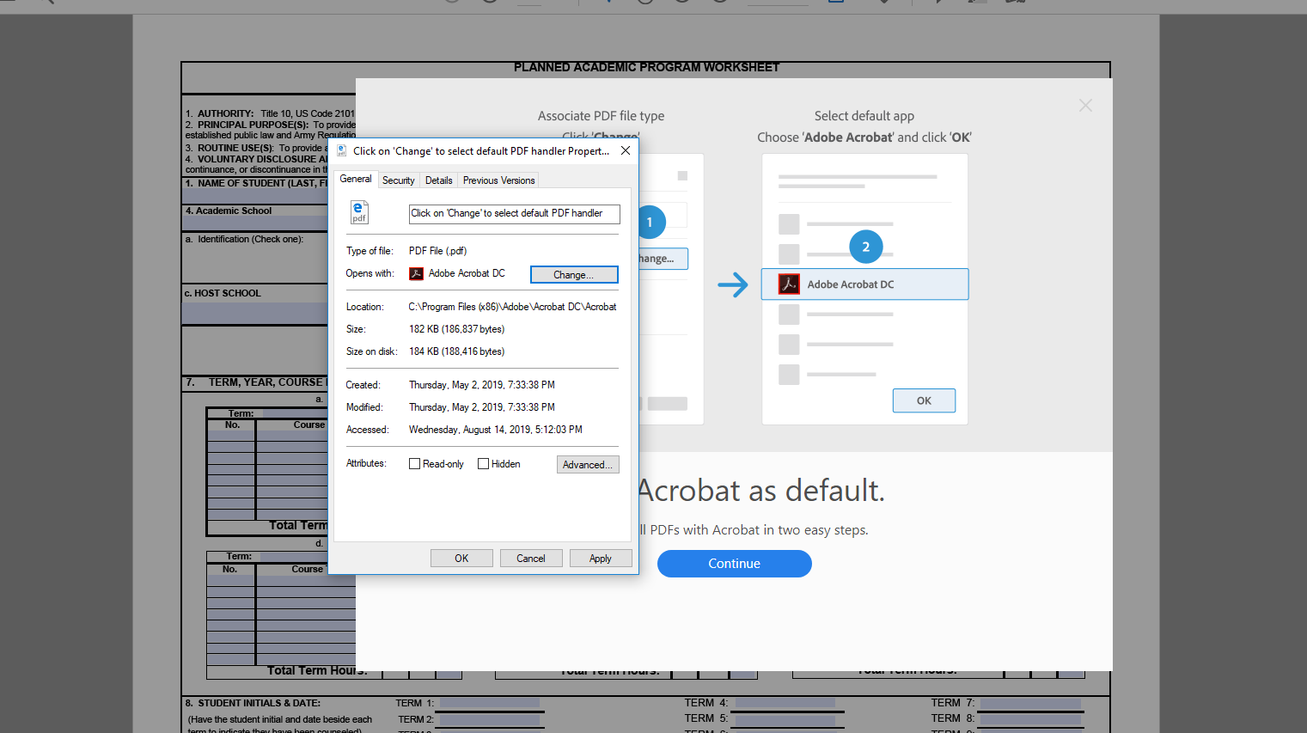
Etc…

Slide 14
Congrats. You can now type in data

